Slide 1
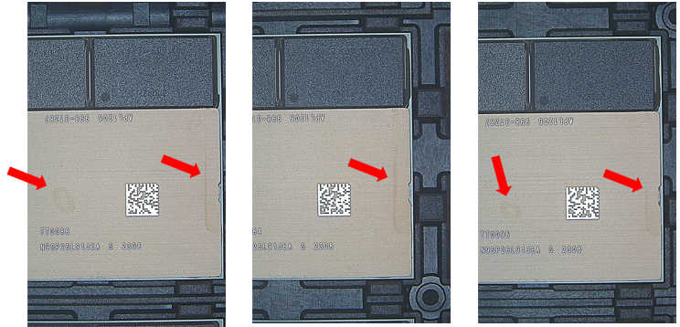
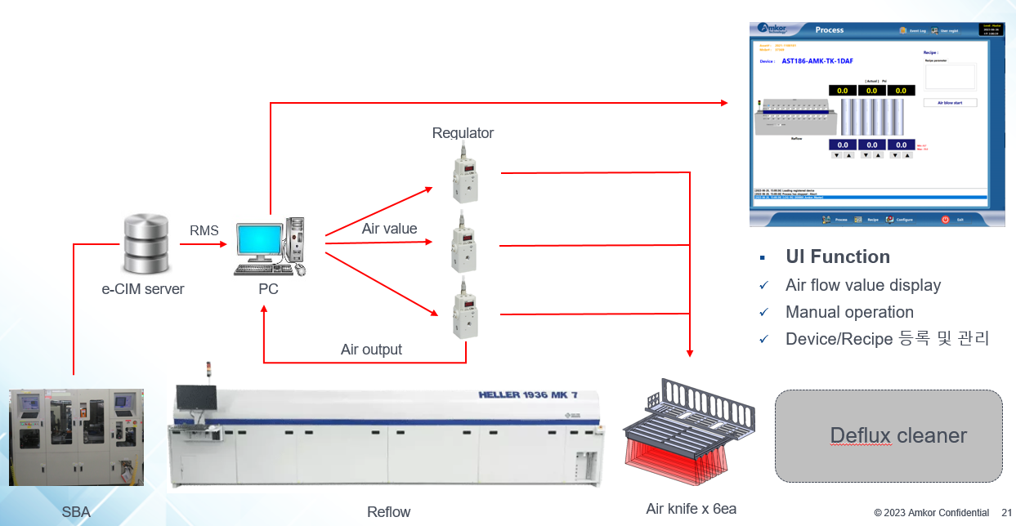
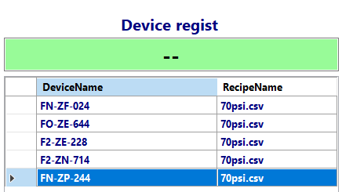
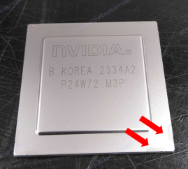
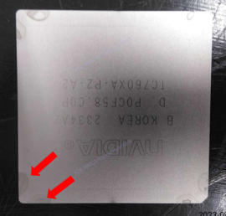
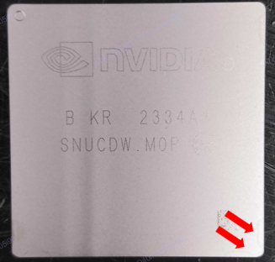
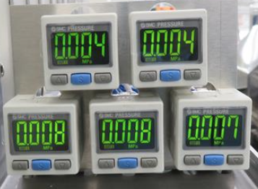
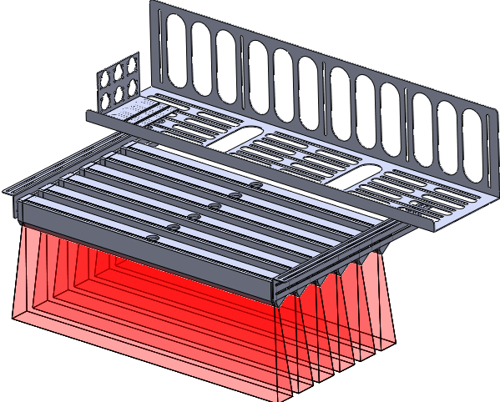
Weekly EED Activity – WW37
K5 / 2T 2P
FCBGA / Reflow
New
K5 FCBGA, Reflow cooling system development
MFG / EED
NA
N/A
[Problem Description]
[Action taken]
Water stain occurred
Heat remaining in the lid causes water stains
After manually removing the water stains, the flow
Quality issues occurred
Reflow cooling system
6 Air knives installed
Recipe air blow parameter settings for each device
Check the Equipment status with e-CIM and start/stop the air blow
Air blow value display, Manual operation
Water stain
Reflow cooling system
Method : Remove water stains manually
Method : Automatic air blow for each device
Cost save :
Quality improvement
TaeGyung Kim, HyunSu Park, BeomYeol Kim, JunCheol Moon(JongMin Park) / ww37 `23 K5EE

